Slide 1






EY Techathon 6.0 Executive Summary
Date of submission:
Notes:
1

Slide 2



Quick introduction
The B2B RFP process in industrial manufacturing is slow, manual, and often inefficient.
Teams spend long hours searching for opportunities, matching product details, and preparing quotations.
This manual effort leads to delays, errors, and missed business deals.
To address this, we propose an AI-driven multi-agent system that automates and streamlines the entire RFP workflow.
The solution enables faster, more accurate, and data-driven responses, improving efficiency and competitiveness.

Slide 3
Tell us about yourself.
Highlight a technical skill or skills each member brings to the team
01#
K. Nichal Haas
Role: Software Design & Modelling
02#
03#
K. Manikanta Reddy
Role: Software Deployment and Monitoring
D. Anvesh
Role: Data pre-processing
04#
D. Siva Karthik Reddy
Role: Software Testing and Validation
05#
L. Subramanyam Reddy
Role: Frontend development and deployment

Slide 4

Problem statement you wish to address and why
(Provide detailed explanation)
The current B2B Request for Proposal (RFP) process in industrial manufacturing firms is highly manual, time-consuming, and prone to inefficiencies. Teams spend extensive hours identifying relevant RFPs from multiple portals, matching them with internal product SKUs, preparing quotations, and estimating competitive pricing.This delays response times and often results in missed business opportunities.
To address this, we aim to build an Agentic AI system that automates and optimizes the entire RFP response lifecycle — from RFP discovery to intelligent product matching and price estimation — using a network of collaborative AI agents.
Our solution transforms a reactive manual workflow into a proactive, autonomous, and data-driven process, enabling faster responses, improved accuracy, and enhanced competitiveness in the B2B market.
Notes:
4

Slide 5
Describe your approach to solving the problem
We propose an Agentic AI-driven multi-agent system that automates the entire RFP response cycle.
The system consists of specialized agents —
RFP Discovery Agent to identify relevant opportunities,
Technical Agent to map product SKUs and specifications,
Pricing Agent to estimate competitive quotes, and
Orchestrator Agent to coordinate their actions and generate the final proposal.
By combining autonomy, reasoning, and collaboration, the solution ensures faster, accurate, and data-backed RFP responses — reducing manual effort and boosting business efficiency.
(Describing Output Form Factor [Mobile App/Web App/Faceless Agent Execution/Chat Bot/Voice Bot Etc], Key User Group, User Journey.
Notes:
5

Slide 6
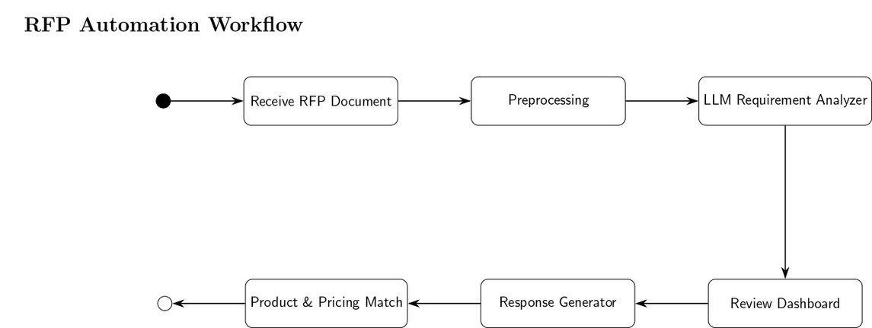
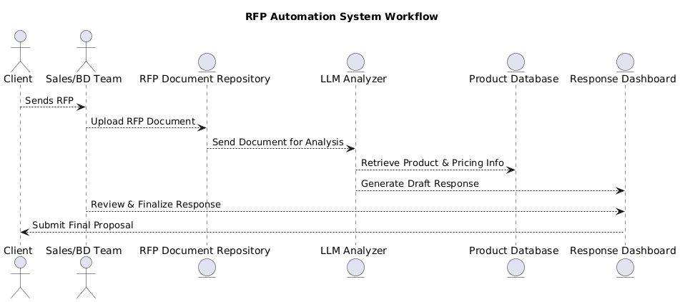
Architecture:
Planned solution design
UML Diagram:
(Diagram and Key Technology components planned for use)
Notes:
6

Slide 7
Potential Benefit from your proposed solution
Reduce Response time
Improved Accuracy and Consistency
Smart Decision Support
Higher Win Rates
Enhanced Collaboration & Transparency
Scalability and Reusability
(Describe in detail the kind of benefit can be planned through your solution, Explain key Matrix, Potential Return on Investment)
Notes:
7

Slide 8









Powered by India's leading enterprises
Thank you for
your attention!

Slide 9


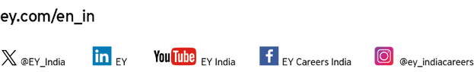

Ernst & Young LLP
EY | Building a better working world
EY is building a better working world by creating new value for clients, people, society and the planet, while building trust in capital markets.
Enabled by data, AI and advanced technology, EY teams help clients shape the future with confidence and develop answers for the most pressing issues of today and tomorrow.
EY teams work across a full spectrum of services in assurance, consulting, tax, strategy and transactions. Fueled by sector insights, a globally connected, multi-disciplinary network and diverse ecosystem partners, EY teams can provide services in more than 150 countries and territories.
All in to shape the future with confidence.
EY refers to the global organization, and may refer to one or more, of the member firms of Ernst & Young Global Limited, each of which is a separate legal entity. Ernst & Young Global Limited, a UK company limited by guarantee, does not provide services to clients. Information about how EY collects and uses personal data and a description of the rights individuals have under data protection legislation are available via ey.com/privacy. EYG member firms do not practice law where prohibited by local laws. For more information about our organization, please visit ey.com.
Ernst & Young LLP is one of the Indian client serving member firms of EYGM Limited. For more information about our organization, please visit www.ey.com/en_in.
Ernst & Young LLP is a Limited Liability Partnership, registered under the Limited Liability Partnership Act, 2008 in India, having its registered office at Ground Floor, Plot No. 67, Institutional Area, Sector - 44, Gurugram - 122 003, Haryana, India.
© 2025 Ernst & Young LLP. Published in India.
All Rights Reserved.
This publication contains information in summary form and is therefore intended for general guidance only. It is not intended to be a substitute for detailed research or the exercise of professional judgment. Neither EYGM Limited nor any other member of the global Ernst & Young organization can accept any responsibility for loss occasioned to any person acting or refraining from action as a result of any material in this publication. On any specific matter, reference should be made to the appropriate advisor.
Page ‹#›
3 November 2025
Presentation title
Notes:
9

